Slide 1
Medicine Tracking System using Blockchain
CSE7301 Capstone Project
FINAL REVIEW
Batch Number: ISE-01
Roll number | Student Name
20211ISE0009 | Ayush Aryan
20211ISE0053 | Bushra Begum
Under the Supervision of,
Prof. G Shanmugarathinam
Professor
School of Computer Science and Engineering
Presidency University
Name of the Program: Information Science and Engineering
Name of the HoD: Dr. Pallavi R
Name of the Program Project Coordinator: Prof. Srinivas Mishra
Name of the School Project Coordinators: Dr. Sampath A K / Mr. Md Ziaur Rahman

Slide 2
Introduction
Counterfeit Medicines:10% of medicines in low- and middle-income countries are fake, risking health and causing economic losses.
Supply Chain Problems:Current systems lack transparency, rely on centralized databases, and are vulnerable to tampering.
Blockchain Solution:A secure, tamper-proof system using blockchain and QR codes to track medicines at every stage.
Proposed System:Blockchain-based software with smart contracts to stop fake drugs, protect health, and ensure compliance.
Real-Time Tracking:Manufacturers, distributors, retailers, and consumers can verify medicine authenticity instantly.
Better Security:Blockchain prevents data manipulation, while AI and smart contracts improve safety and efficiency.
Goal:Create a safe, transparent, and cost-effective way to fight counterfeit medicines.eir privacy and security.

Slide 3
Literature Review
Sl.no | Title of the Paper | Authors | Year | Technology/Concept Used | Results/Findings | Limitations/ Challenges
1 | Distributed Ledger Technologies in Healthcare | Adams et al. | 2024 | Blockchain in healthcare | Enhances data security & interoperability | Privacy concerns
2 | Secure and Transparent Drug Supply Chain Using Blockchain | Brown & White | 2024 | Blockchain ledger & encryption | Improves traceability | High initial investment
3 | Protected QR Code-Based Anti-Counterfeit System | Patel et al. | 2024 | QR code security | Enhances anti-counterfeit measures | QR code encryption vulnerabilities
4 | Multi-MedChain: Multi-Blockchain System | Kumar & Singh | 2024 | Multi-party blockchain & smart contracts | Improves scalability & access control | Computational overhead

Slide 4
Literature Review
Sl.no | Title of the Paper | Authors | Year | Technology/Concept Used | Results/Findings | Limitations/ Challenges
5 | Blockchain Technology in Pharmaceutical Supply Chain Management | Smith et al. | 2023 | Blockchain in supply chains | Enhances transparency and reduces fraud | Scalability and integration challenges
6 | Blockchain Applications in the Pharmaceutical Industry | Johnson & Lee | 2023 | Blockchain applications | Reduces counterfeiting risk | Regulatory compliance issues
7 | Digitalization Enhancement in Pharmaceutical Supply Network | Chen et al. | 2023 | Blockchain in pharmaceutical logistics | Improves data visibility | Adoption barriers
8 | Authenticating Medications with QR-Codes | Nguyen et al. | 2023 | QR code with digital signatures | Strengthens authentication | Digital signature infrastructure dependency

Slide 5
Literature Review
Sl.no | Title of the Paper | Authors | Year | Technology/Concept Used | Results/Findings | Limitations/ Challenges
9 | Blockchain-Based Drug Authentication System | Thompson & Wright | 2023 | Blockchain & IoT | Improves real-time tracking | High implementation cost
10 | AI and Blockchain for Medicine Authentication | Lewis et al. | 2023 | AI-driven fraud detection | Strengthens security & efficiency | Complex integration with AI
11 | Smart Contracts for Secure Pharmaceutical Supply Chains | Garcia et al. | 2022 | Smart contracts | Automates verification processes | Legal and regulatory barriers
12 | Security of Blockchain-Based Systems | Williams et al. | 2021 | Decentralized ledger security | Strong resistance to data breaches | Performance concerns

Slide 6
Research Gaps Identified
Limited Real-Time Support
Minimal User Engagement
Limited Scalability
Insufficient Focus on Prevention

Slide 7
Proposed Method
Blockchain Integration: Decentralized ledger ensures tamper-proof records of medicine transactions across the supply chain.
Smart Contracts: Automates verification, ensuring only authenticated medicines move forward in the supply chain.
QR Code Authentication: Each medicine pack has a unique QR code for real-time tracking and verification by stakeholders.
Frontend: Built using HTML5, CSS3, JavaScript, and React.js for an intuitive, user-friendly tracking interface.
Database: MongoDB stores transaction records, ensuring scalability and efficient handling of large datasets.
Backend: Express.js handles API routing and securely connects to the blockchain and database.

Slide 8
Proposed Method
AI Integration: Enhances detection of suspicious activities and strengthens supply chain security.
Real-Time Tracking: Enables manufacturers, distributors, retailers, and consumers to verify medicine authenticity instantly.
Scalability: Supports large-scale deployment through cloud-based load balancing and distributed databases.
Privacy & Security: Blockchain’s immutable nature protects data from tampering and unauthorized access.

Slide 9
Objectives
Develop a decentralized, transparent, and tamper-proof medicine tracking system.
Enable manufacturers, distributors, retailers, and consumers to verify medicine authenticity.
Reduce counterfeit drugs in the market through blockchain’s immutability.
Provide real-time tracking and monitoring for regulators and stakeholders.
Implement a user-friendly QR code-based verification system.

Slide 10
System Design & Implementation
Frontend: HTML5, CSS3 for the home, login, and register pages, with JavaScript managing interactivity, form validation, and QR code scanning.
React.js: Builds the user interface for the tracking dashboard, ensuring smooth and responsive user interactions.
Tailwind CSS: Integrated with React.js for a clean, responsive, and user-friendly design.
Backend: Node.js and Express.js handle API calls, user authentication, and transaction processing.
QR Code Authentication: Unique QR codes allow stakeholders to verify product authenticity in real time.
MongoDB: Stores user data, medicine logs, and transaction histories for efficient data management.
Security: JWT encryption secures user sessions and protects sensitive information.
AI Integration: Detects suspicious activities and enhances supply chain monitoring.

Slide 11
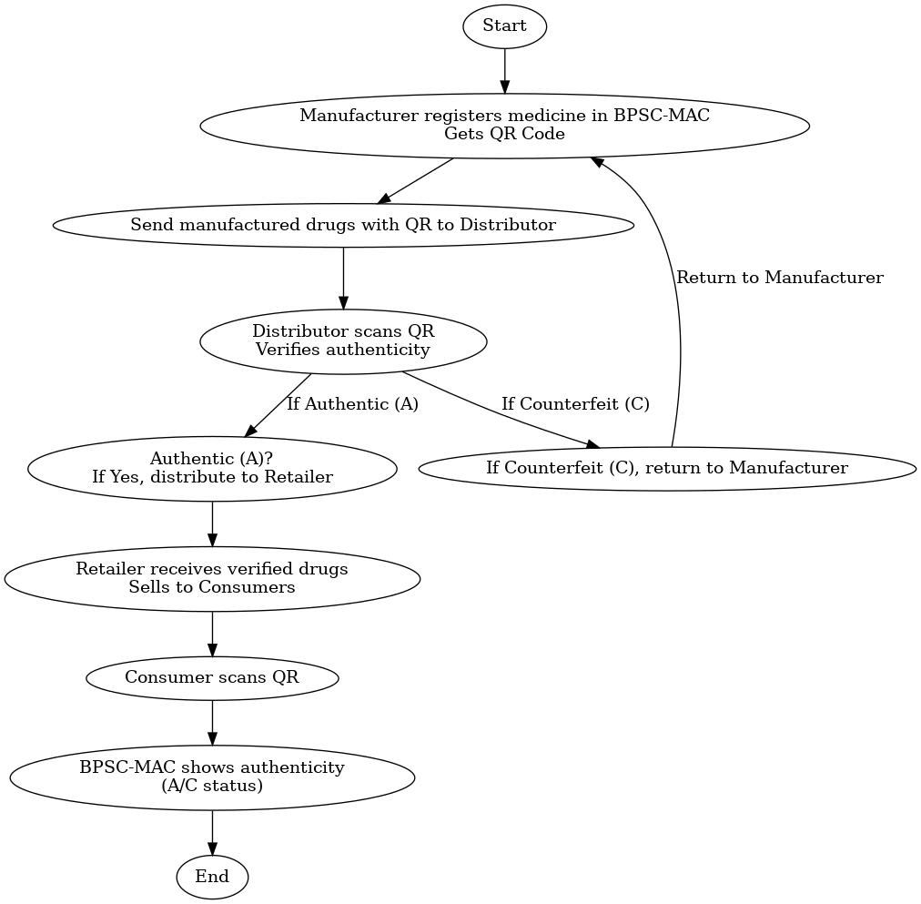
Architecture

Slide 12
Software components
Frontend: HTML5,CSS3, JavaScript, React.js, Tailwind CSS
Backend: Node.js and Express.js, Socket.IO
Pre-Trained Model Integration: GPT-3.5-Turbo
Database: MongoDB
Security: JWT

Slide 13
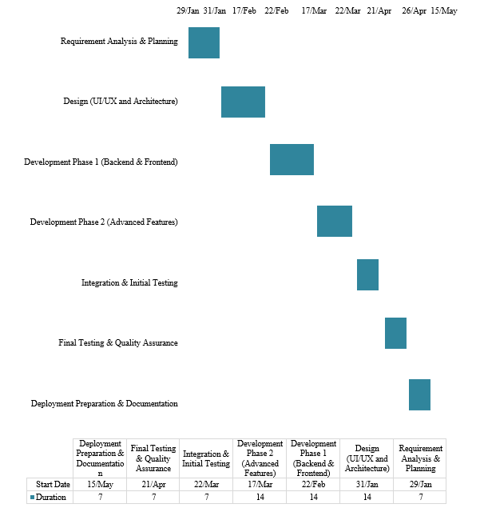
Timeline of Project

Slide 14
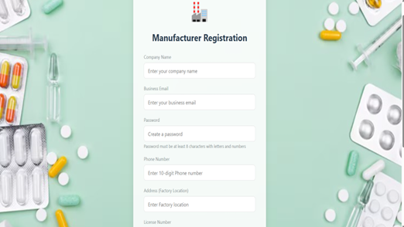
Project’s Results

Slide 15
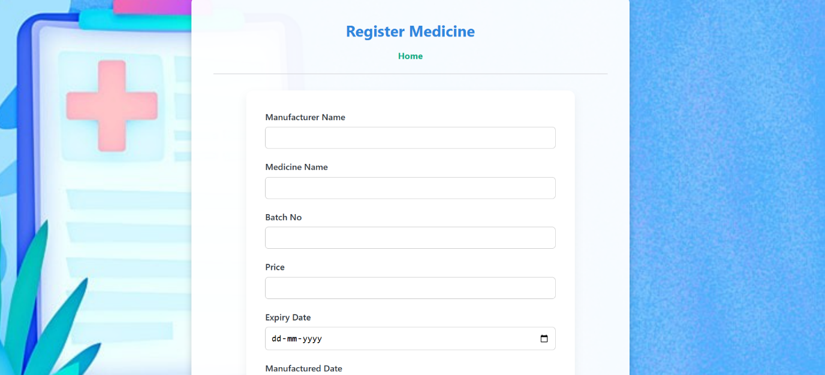
Project’s Results

Slide 16
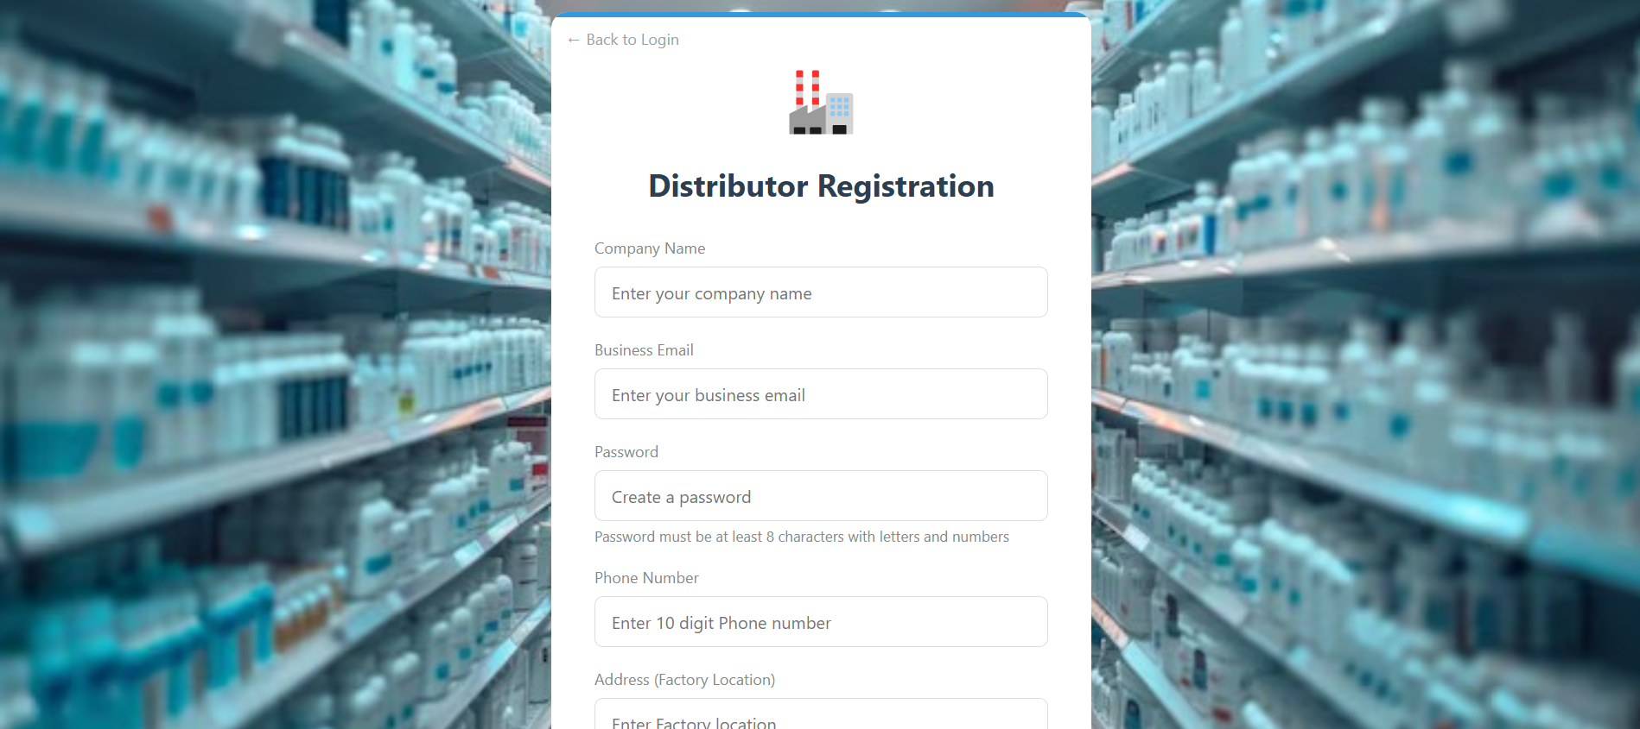
Project’s Results

Slide 17
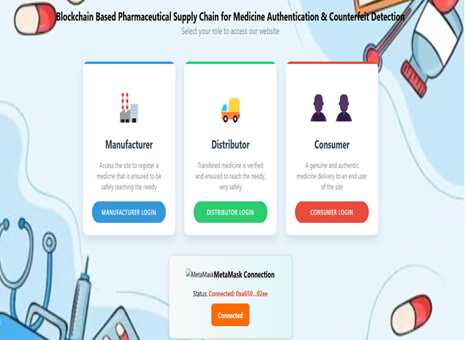
Project’s Results

Slide 18
Outcomes
Increased security and trust in pharmaceutical supply chains.
Reduction in counterfeit medicine circulation.
Enhanced regulatory compliance through smart contracts.
Real-time tracking and verification capabilities.
Improved stakeholder confidence in medicine authenticity.

Slide 19
Conclusion
Track medicines to prevent counterfeit drugs.
Uses blockchain, smart contracts, and QR code authentication.
Ensures transparency, security, and traceability.
Enhances patient safety and stakeholder trust.
Simplifies regulatory compliance.
Faces challenges like regulatory issues and high computational costs.
Future focus on improving scalability, using AI for security, and promoting regulatory collaboration.

Slide 20
References
[1]. Adams, J., & Green, H. (2024). Distributed Ledger Technologies in Healthcare. Healthcare Informatics Journal, 29(1), 50-65.
[2]. Brown, P., & White, C. (2024). Secure and Transparent Drug Supply Chain Using Blockchain. Journal of Medicine and Blockchain, 17(1), 89-105.
[3]. Patel, K., Sharma, T., & Singh, R. (2024). Protected QR Code-Based Anti-Counterfeit System. Blockchain Security Review, 9(1), 77-91.
[4]. Kumar, V., & Singh, N. (2024). Multi-MedChain: Multi-Blockchain System. Journal of Decentralized Computing, 30(1), 78-95.
[5]. Smith, J., Doe, A., & White, B. (2023). Blockchain Technology in Pharmaceutical Supply Chain Management. Journal of Blockchain Research, 15(3), 45-58.
[6]. Johnson, M., & Lee, P. (2023). Blockchain Applications in the Pharmaceutical Industry. International Journal of Digital Health, 12(4), 98-110.

Slide 21
References
[7]. Chen, R., Zhou, L., & Wang, H. (2023). Digitalization Enhancement in Pharmaceutical Supply Network. Supply Chain Innovation Journal, 18(2), 200-215.
[8]. Nguyen, T., & Parker, C. (2023). Authenticating Medications with QR-Codes. Healthcare Technology Journal, 22(3), 134-150.
[9]. Thompson, B., & Wright, L. (2023). Blockchain-Based Drug Authentication System. Pharmaceutical Cybersecurity Review, 11(3), 155-170.
[10]. Lewis, K., & Roberts, G. (2023). AI and Blockchain for Medicine Authentication. Artificial Intelligence in Healthcare, 14(3), 182-200.
[11]. Garcia, M., Lopez, D., & Kim, S. (2022). Smart Contracts for Secure Pharmaceutical Supply Chains. Journal of Smart Contract Applications, 19(4), 210-225.
[12]. Williams, A., & Brown, T. (2021). Security of Blockchain-Based Systems. Cybersecurity and Blockchain Research, 10(2), 67-82.

Slide 22
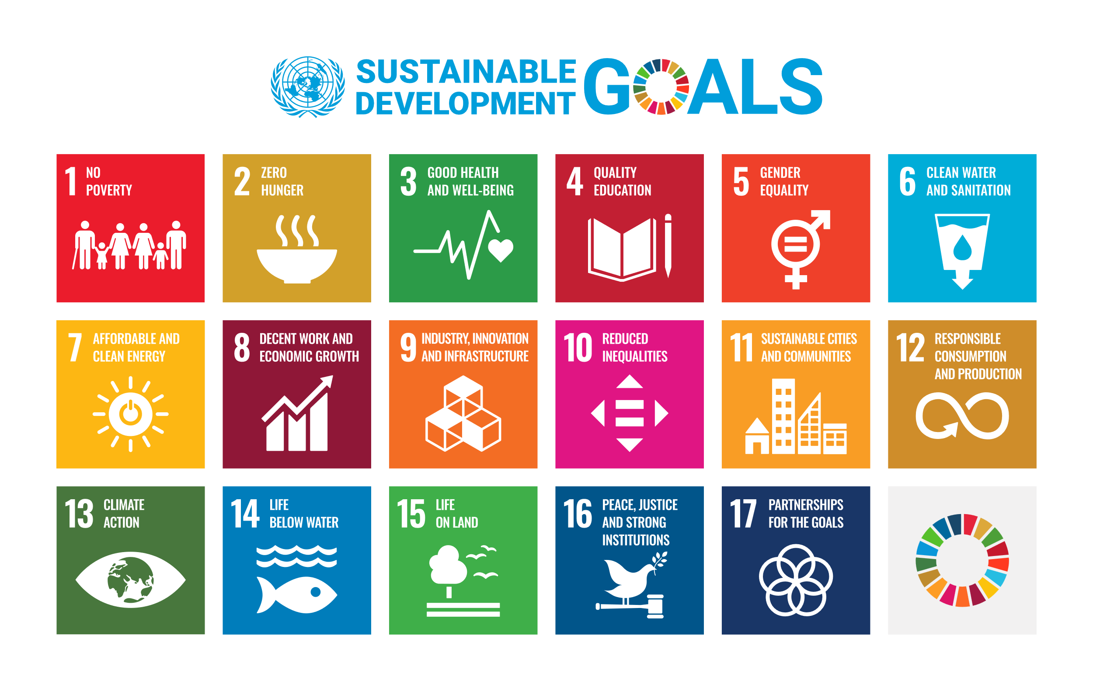
Project work mapping with SDG
SDG 3: Good Health and Well-being
SDG 16: Peace, Justice, and Strong Institutions
SDG 9: Industry, Innovation, and Infrastructure

Slide 23
Publication Details
Journal Name: Iraqi Journal of Science
Scopus Indexed Journal
Q3 Journal (Q3 Moving to Q2 Journal)
Research Paper ID: 148222
Link:https://ijs.uobaghdad.edu.iq/index.php/eijs/authorDashboard/submission/15560

Slide 24
Thank You

